Slide 1


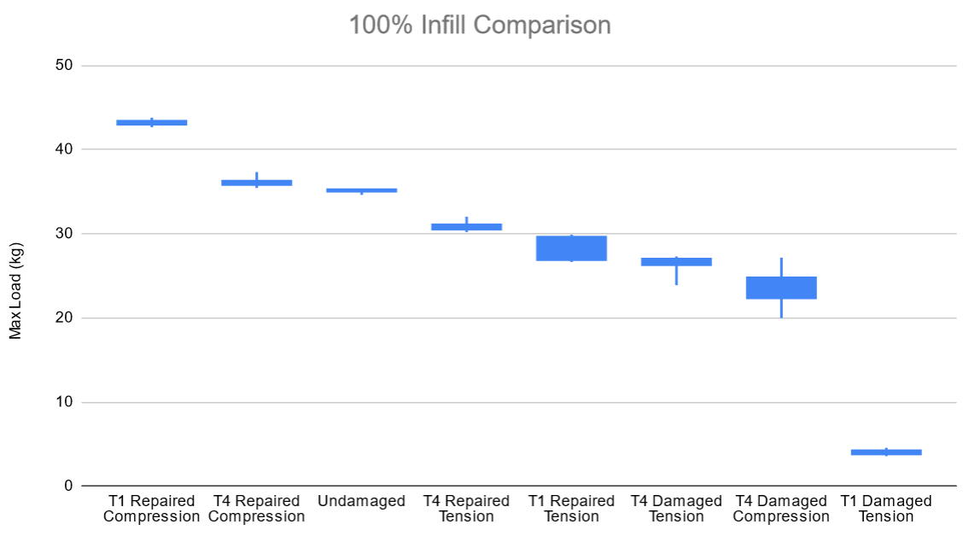
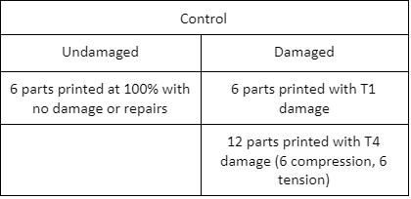
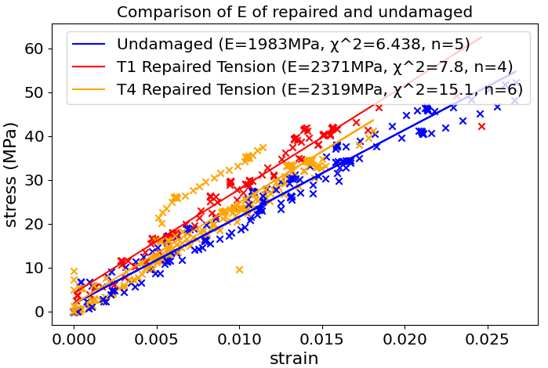
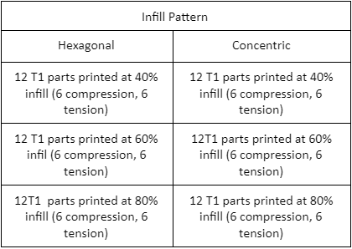
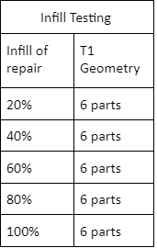
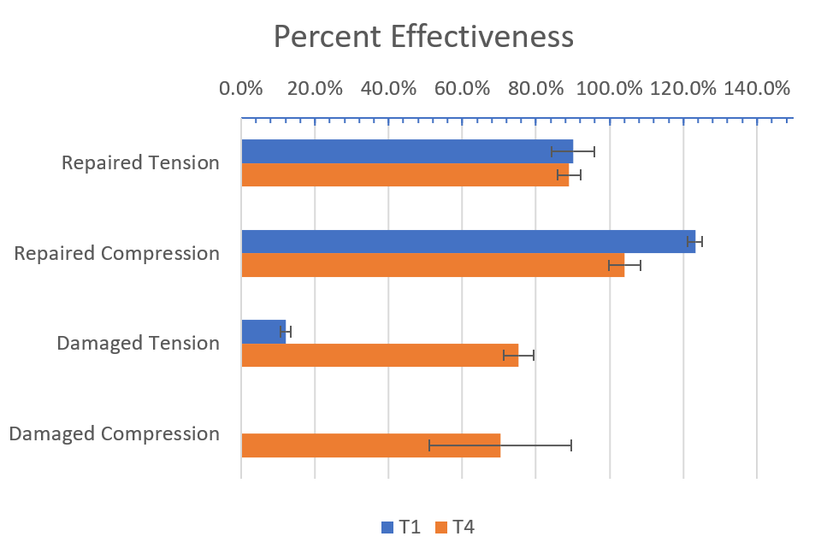
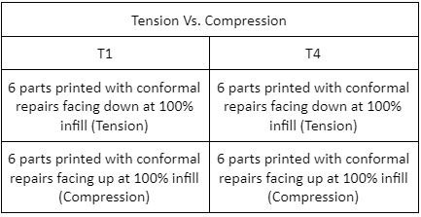
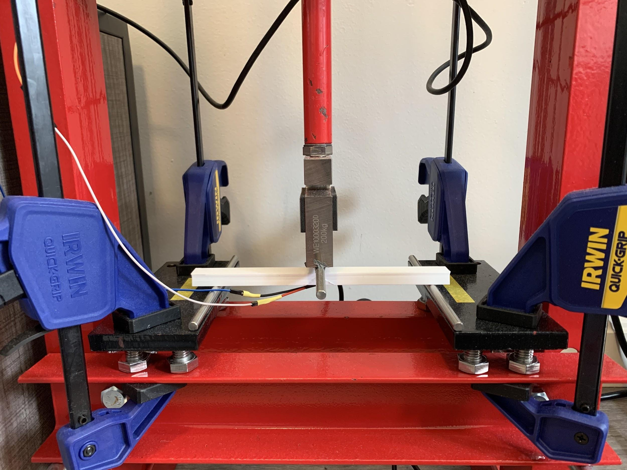
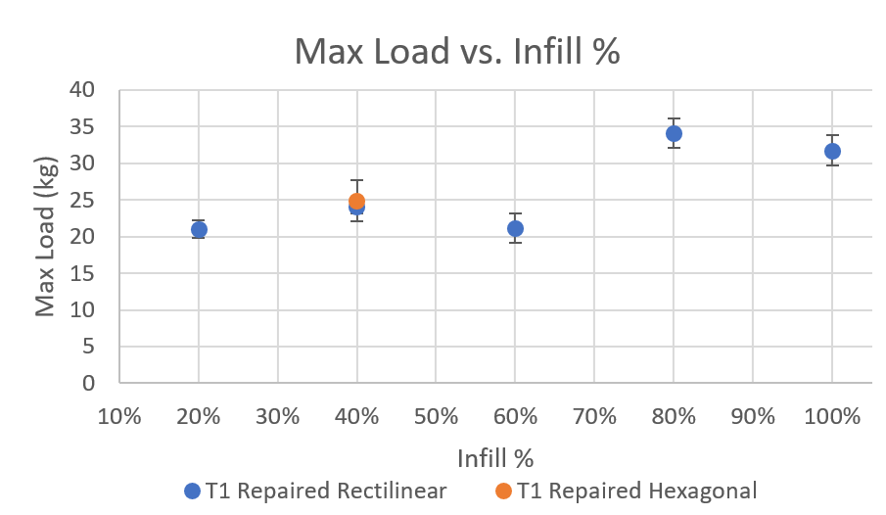
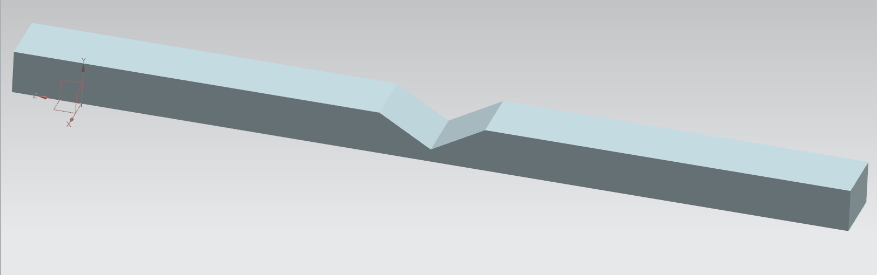
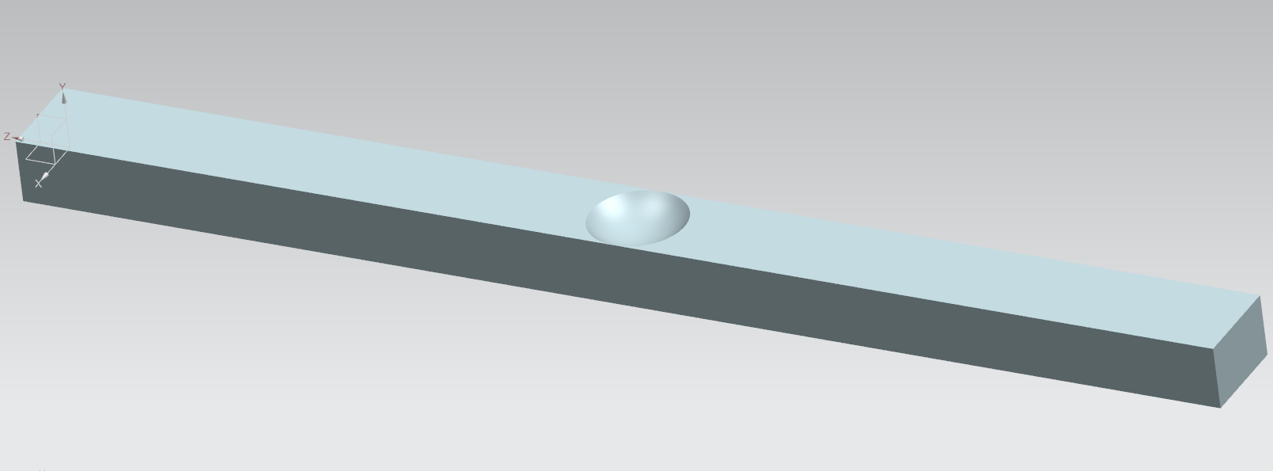
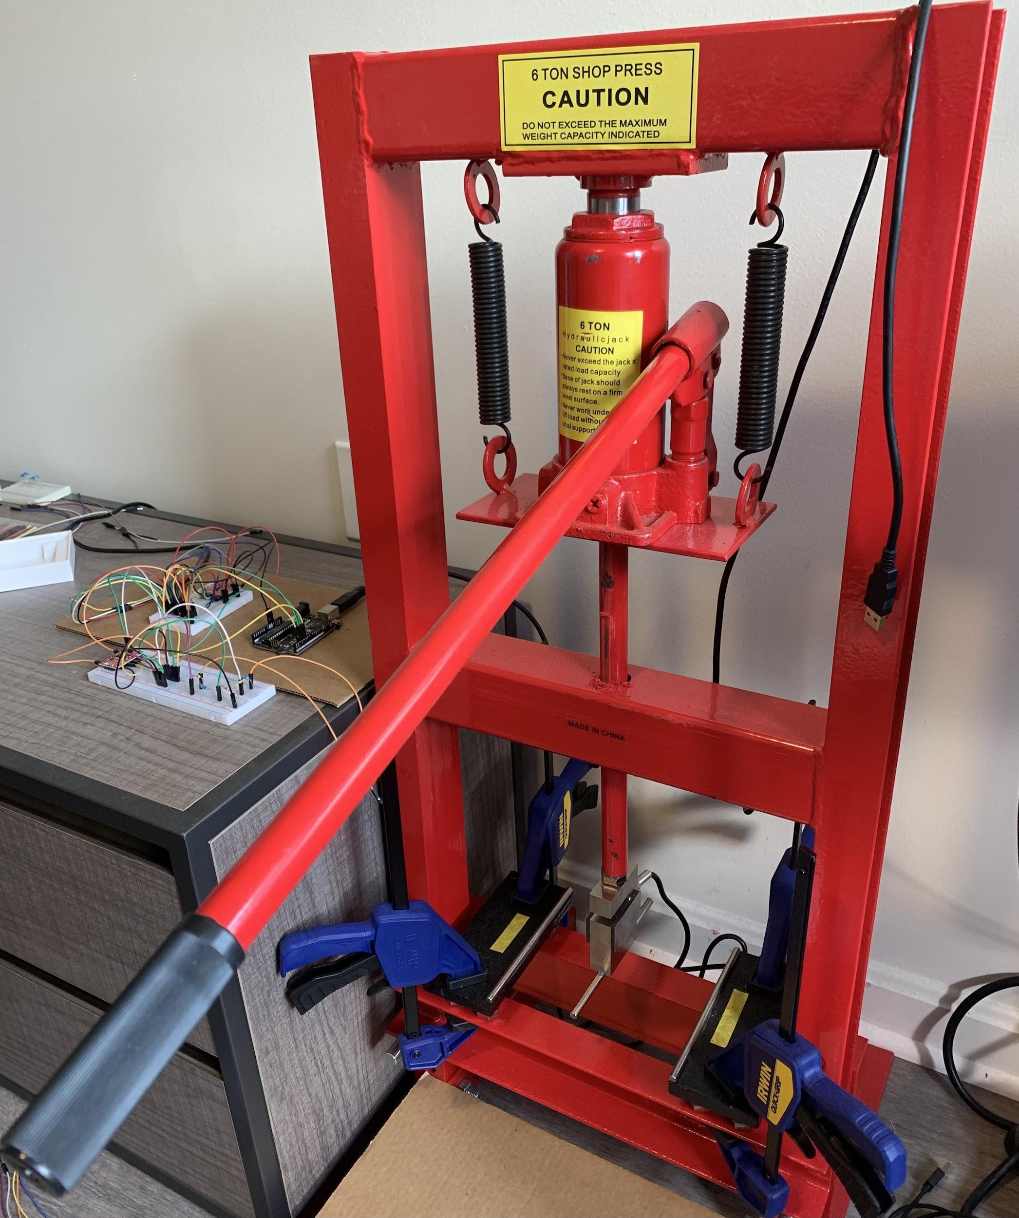
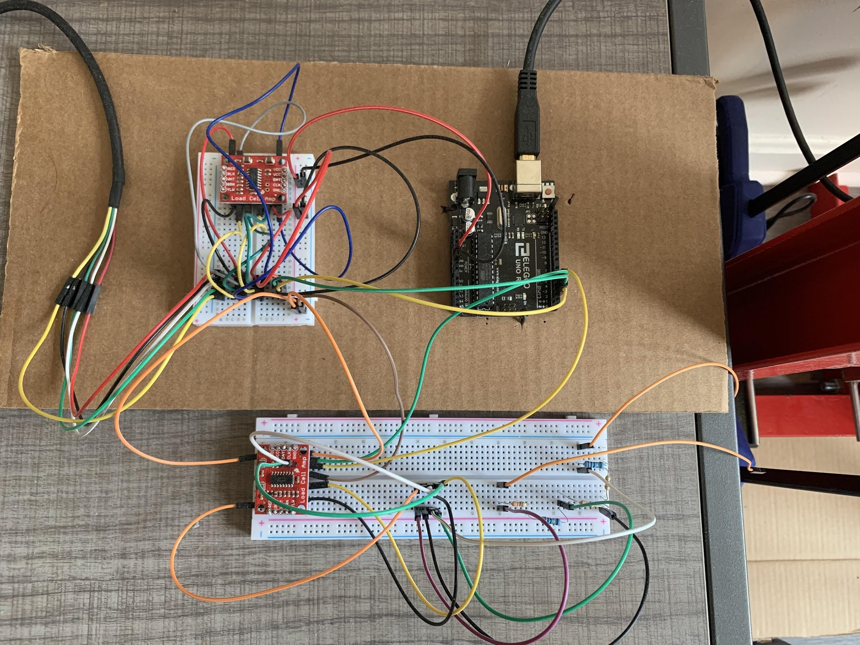
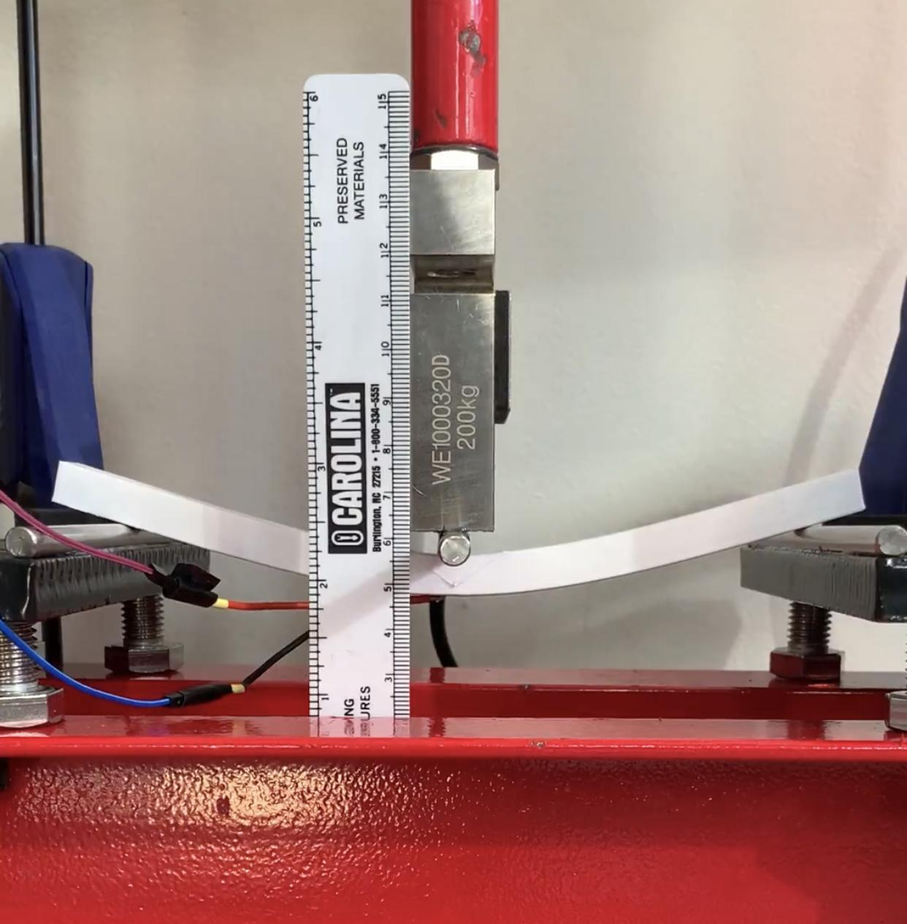
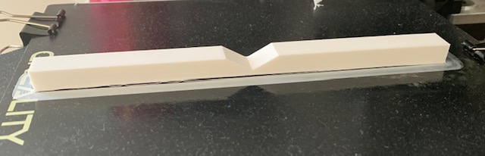
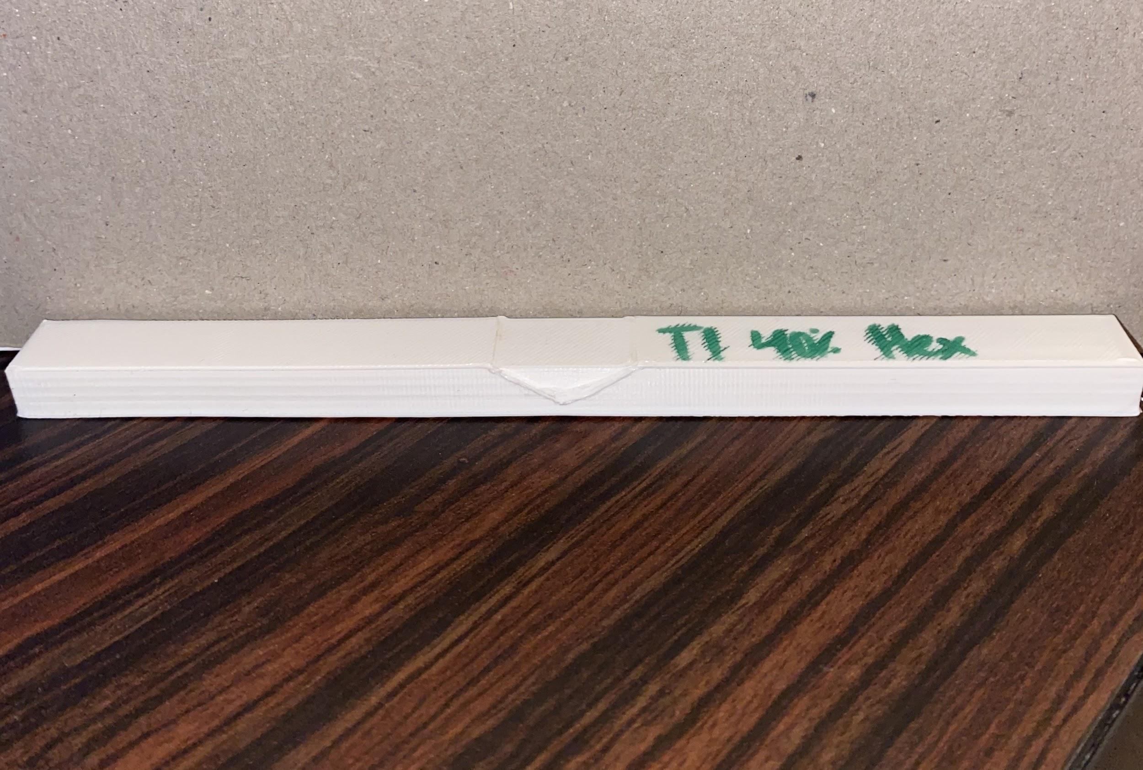

In Situ Conformal 3D Printing for Targeted Repairs
Rohith Chintala, Brendan Cutick, Tyler Han, Elizabeth Myers, Eric Oh, Aidan Sandman-Long, Cynthia Sheng, Nathan Spicer-Davis
Team PRINT
Mentor: Dr. Steven Mitchell
Abstract
Methodology
Results
Additive manufacturing enables the construction of near-arbitrary structures with the help of computational tool-path planning and print material properties. We explore an application of the technology to targeted repairs, such as mending holes or cracks, on 3D printed parts by using conformal tool-pathing, combining the precision of additive manufacturing with the strength and homogeneity of material adhesion. Repair configurations varying in shape, size, material, infill and loading type are tested in 3-point bending for structural strength and strain. We provide and summarize the collected data in addition to a structural analysis and optimization of parameters relevant to reparative 3D printing.
The following properties were chosen for experimentation of the repaired samples:
Percentage Infill: relative density of the internal structure (100% = solid)
Tension vs. Compression: loading configurations where the repair was in tension (bottom of sample) or in compression (top of sample)
Infill Pattern: geometric pattern of interior supportive structure (hexagonal or rectilinear)
Shown to the right is a box plot summarizing the tests conducted thus far, depicting the distribution of maximum load before failure. From this we can see the effectiveness of the repair.
Strain (elongation) data is also collected for the repaired and undamaged specimens to see changes in Young’s modulus:
The controls for these experiments are whole-printed, 100% infill samples, which function to simulate undamaged 3D printed parts. The number of samples tested abide by the ASTM standard.
Details of these experiments can be summarized by the following tables:
Research Question:
How effective is repairing 3D printed structures with conformal 3D printing?
Overview
An effectiveness rating better compares the load held by repaired vs. undamaged specimen. Percent effectiveness is defined as the load held normalized by the load held by the average undamaged specimen.
Background:
3D printing is typically used in quickly prototyping parts but has recently garnered interest in more complex projects such as rocket engines, bone repair, and in-orbit manufacturing
Large-scale engineering projects will require data on the limitations of 3D printing
Methodology:
3D printed parts are tested using the 3-point bend test, which provides data on the structure’s ultimate strength, failure method, and deformation under load
Provided a 3D printed object and full information about a region of damage (such as a cavity), a surface-conforming print fills and repairs the damage while meeting repair shape and infill constraints
Results:
By subjecting repaired parts to the 3-point bend test, our data suggests significant improvements in structural strength
Repaired structures in compression exceed structural strength of original, undamaged structure
Discussion
Conclusion:
Testing demonstrates that repair to the structure results in a statistically significant improvement in the maximum load as demonstrated in either the T1 tension repaired and T4 tension repaired with rectilinear infill using a two-tailed t-test (T1 repaired vs. Undamaged: t(5)=6.2, p=0.0016), T4 repaired vs. Undamaged: t(9)=6.2, p<0.001).
More work is needed to in order to understand how adjusting other parameters, such as 3D printer settings, can affect performance.
Testing data corroborates the result observed in literature that optimal infill % for maximum load is not 100% but instead ~80%
An unexpected result is that repairs perform better than undamaged specimen when experiencing compressive loading (t(8)=17.2, p<0.001). It is possible that this is a phenomenon similar to why 80% infill is stronger than 100% infill: the space created in lowering infill % allows the internal geometry of the 3D print to maintain its structural integrity as opposed to a solid print which would be compromised almost immediately.
Without access to a testing facility, a 3-point bend test apparatus was instead designed and assembled using a hand-operated hydraulic jack, steel shafts for support and point loading, and a force sensor and strain gauges for taking measurements.
Force sensor mounted on press measures applied load
Strain gauge attached to bottom side at loading point
Rounded D-shafts at supports and loading point ensure loads on beam are applied at single points
Below is a summary of the current data collected from tests while varying infill % and infill pattern:
Example Test Samples
Future Work
An Ender 3 Pro 3D Printer is used to print simulated damaged samples. We chose to investigate triangular cutouts (T1) and hemispherical cutouts (T4).
Figure 5. 3-point bend test setup
Goals planned:
T1 design testing while different infills pattern, allowing an analysis of which infill pattern may be more effective than others
Testing various damage types in order to improve repair methods in addition
Testing new materials such as ABS and Carbon Fiber PLA
Multivariate data analysis for optimization of printing, structural, and material parameters
Physical analysis supporting why repaired structures in compression perform better than their undamaged counterpart
Study of parameters vital in obtaining information about damaged regions (assumed given in this work)
In general, reparative printing has many applications. Provided that these printing methods have well-studied limitations, automated reparative printing is a promising material-efficient alternative to whole replacement and/or manual repair.
While this project limits testing to primarily plastics, it is equally possible to additively manufacture other materials like metal or biological tissue, from which general reparative printing can benefit greatly.
Figure 1. T1 CAD model
Figure 2. T4 CAD model
Once the damaged piece is printed and cooled, the Ender 3 Pro runs a separate repair print that varies in infill pattern and infill percentage. Below is an example of a T1 sample before and after a repair.
Figure 6. Full apparatus
Figure 7. Full Arduino circuit
Figure 8. Repaired piece in compression
Acknowledgements and Citations
A test is conducted in the following manner:
Pump the hand lever to increase the applied load with each downstroke until failure (snapping, cracking, extreme stretching)
An Arduino circuit reads in data from the force sensor and strain gauge, providing the necessary information to determine the failure load and stress/strain curve
We would like to thank our mentor Dr. Steven Mitchell and the University of Maryland Gemstone Honors Program for supporting this work
Figure 3. T1 pre-repair
Figure 4. T1 post-repair
Notes:
TEXT FORMATTING RULES:
“add space after paragraph”
font size: 24
‹#›

Slide 2
Overview
Background:
3D printing is typically used in quickly prototyping parts but has recently garnered interest in more complex projects such as rocket engines, bone repair, and in-orbit manufacturing
Large-scale engineering projects will require data on the limitations of 3D printing
Methodology:
3D printed parts are tested using the 3-point bend test, which provides data on the structure’s ultimate strength, failure method, and deformation under load
Provided a 3D printed object and full information about a region of damage (such as a cavity), a surface-conforming print fills and repairs the damage while meeting repair shape and infill constraints
Results:
By subjecting repaired parts to the 3-point bend test, our data suggests significant improvements in structural strength
Repaired structures in compression exceed structural strength of original, undamaged structure

Slide 3
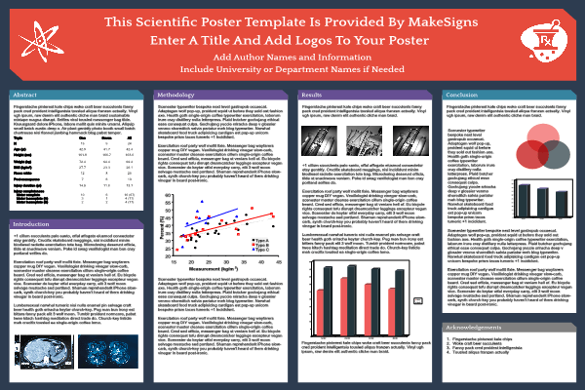
Formatting - PLEASE READ
1) right-click the top rule bar (under tool ribbon) and click “show vertical guides”
2) google “research poster” and use them as reference - i like this one: here’s Team CASCADE’s (https://drum.lib.umd.edu/bitstream/handle/1903/25847/URD%20Poster.pdf?sequence=1&isAllowed=y) 3) let’s use a single font: I like roboto (we can change later)

Slide 4
4) you can change the theme (background) by going to: slide>edit master
5) try to copy the section block style or design a better one if you want
6) feel free to move sections around and make space - none of the poster is set in stone
7) please try to keep the format as best as possible
8) if you can’t click on an element in a section move the obstructing object back by clicking on it and hitting “ctrl + <down>” until it is no longer obstructing

